Slide 1

HR DATA ANALYSIS
Mahendra Nagdeve
© All rights reserved by Fireblaze Technologies Pvt. Ltd.

Slide 2
Problem Statement
Organizations collect extensive employee data but often lack the insights needed to make informed HR decisions. High attrition rates, poor job satisfaction, and low productivity can go unnoticed without proper analysis.
This project aims to analyze HR data to:
Understand the key factors driving employee attrition and retention.
Identify patterns in performance, job satisfaction, and promotions.
Predict potential turnover risks using data-driven methods.
Support HR strategies with actionable insights to improve workforce management.
✅ Goal
Enable data-driven HR decisions to enhance employee satisfaction, reduce attrition, and boost organizational performance.
© All rights reserved by Fireblaze Technologies Pvt. Ltd.

Slide 3
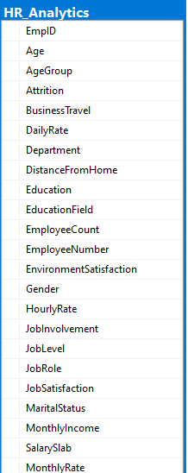
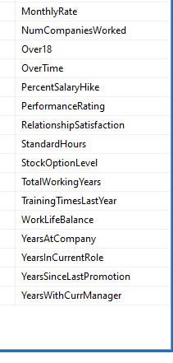
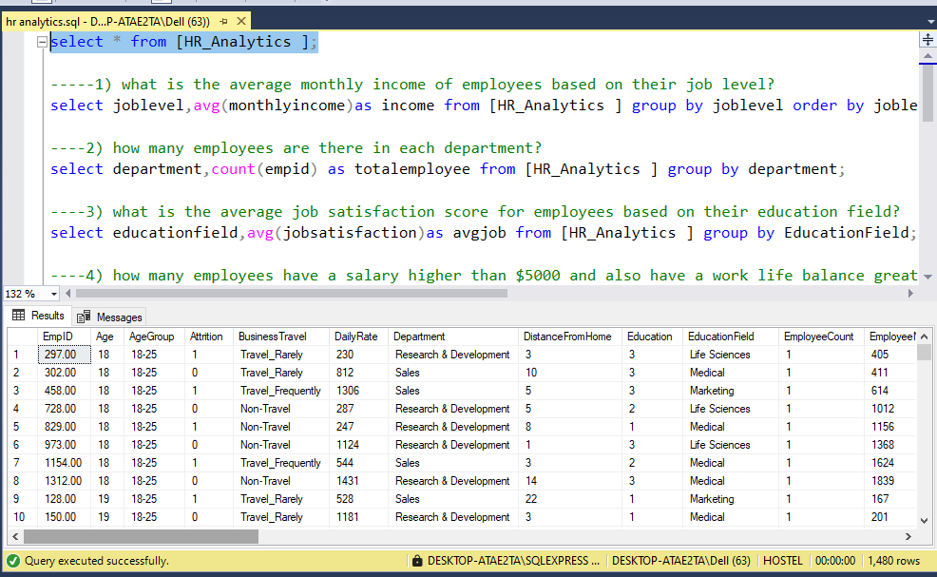
About the Data
select * from [HR_Analytics ];
© All rights reserved by Fireblaze Technologies Pvt. Ltd.

Slide 4
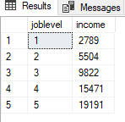
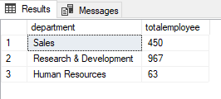
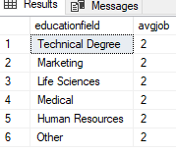
Proposed Solution
1)what is the average monthly income of employees based on their job level?
select joblevel,avg(monthlyincome)as income from [HR_Analytics ] group by joblevel order by joblevel;
2) how many employees are there in each department?
select department,count(empid) as totalemployee from [HR_Analytics ] group by department;
3) what is the average job satisfaction score for employees based on their education field?
select educationfield,avg(jobsatisfaction)as avgjob from [HR_Analytics ] group by EducationField;
© All rights reserved by Fireblaze Technologies Pvt. Ltd.

Slide 5
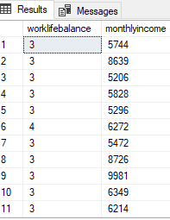
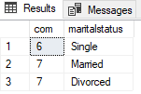
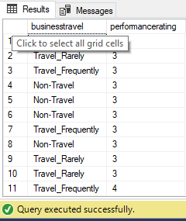
Proposed Solution
4) how many employees have a salary higher than $5000 and also have a work life balance greater than 3?
select worklifebalance,monthlyincome from [HR_Analytics ] where MonthlyIncome >5000 and WorkLifeBalance >=3;
5)what is the average numbers of years employees have been with the company,grouped by marital status?
select avg (yearsatcompany) as com,maritalstatus from [HR_Analytics ] group by MaritalStatus order by MaritalStatus desc;
6) what is the total number of employees who travel for business and have performance rating of more then 3 ?
select businesstravel,performancerating from [HR_Analytics ] where PerformanceRating >=3;
© All rights reserved by Fireblaze Technologies Pvt. Ltd.

Slide 6
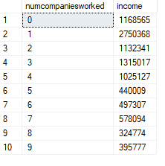
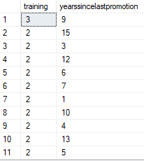
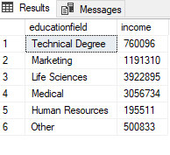
Proposed Solution
7) how does the number of companies an employee has worked for corelate with their monthly income?
select numcompaniesworked,sum(monthlyincome) as income from [HR_Analytics ] group by NumCompaniesWorked order by NumCompaniesWorked;
8) what is the average training times last year for employees who have been promoted (i.e.,years since last promotion>0)?
select avg (trainingtimeslastyear) as training,yearssincelastpromotion from [HR_Analytics ] where YearsSinceLastPromotion>0 group by YearsSinceLastPromotion;
9) can you find the education field and monthly income for individuals with a montly income greater than 7000?
select educationfield,sum (monthlyincome) as income from [HR_Analytics ] group by EducationField having sum (monthlyincome) > 7000;
© All rights reserved by Fireblaze Technologies Pvt. Ltd.

Slide 7
Conclusion
Identify the primary drivers of employee turnover.
Highlight patterns in employee performance and satisfaction.
Predict potential attrition using machine learning models.
Recommend actionable strategies to improve retention and productivity.
© All rights reserved by Fireblaze Technologies Pvt. Ltd.

Slide 8
Future Scope
1.Predictive Workforce Planning Use machine learning to forecast hiring needs, skill gaps, and attrition risks, enabling proactive workforce strategies.
2.Integration with AI and Automation Automate resume screening, performance evaluations, and employee feedback analysis using AI-powered tools.
3.Real-Time Analytics Dashboards Implement real-time HR dashboards for continuous monitoring of KPIs such as attrition, engagement, and diversity.
4.Employee Sentiment & Behavioral Analysis Leverage natural language processing (NLP) to analyze employee feedback, surveys, and communications for deeper insights.
5.Personalized HR Interventions
6.Cross-Departmental Insights
© All rights reserved by Fireblaze Technologies Pvt. Ltd.

